Slide 1

Going real time using Azure CosmosDB and React
Olena Borzenko
@borzenko_lena

Slide 2

Stock information
Warehouse state
Movements
Notes:
Movements – as they drives a physical process in a warehouse Next thing which is important for us is to know is that we have the right amount of stock And if stock is in a right place

Slide 3


Update state of a Warehouse
Movement
event
Calculate stock
Notes:
Fully managed database

Slide 4

Flexibility
Notes:
Reporting, shipping, receiving, inventory tracking, pick-and-pack, labor management

Slide 5
Stock monitoring
Notes:
Reporting, shipping, receiving, inventory tracking, pick-and-pack, labor management

Slide 6





Calculate stock
Notes:
Stock information

Slide 7

Simplicity
Notes:
Reporting, shipping, receiving, inventory tracking, pick-and-pack, labor management

Slide 8









Event-Computing and Notification
Stream Processing
New events (writes)
Change feed
Data movement

Slide 9
Function app
HTTP
trigger
CosmosDB
trigger
CosmosDB
binding
SignalR
binding
Notes:
Function app – unit of deployment and development, can have many functions; Triggers – an event which will start the functions and one per function;
Bindings –”input” data that is pulled in at the start before an execution.
Output – data that is pushed out after an execution.
Can have multiple of each

Slide 10
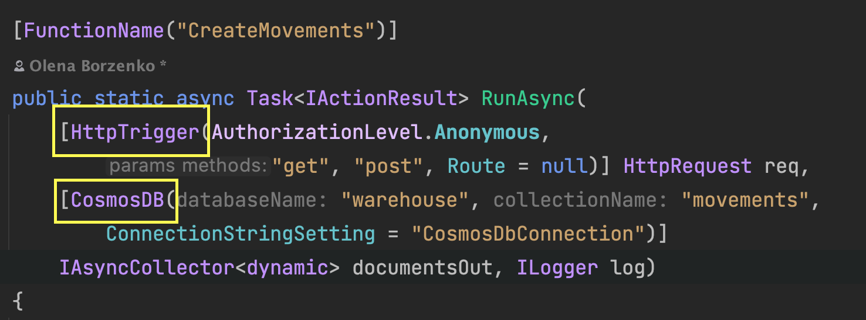
Create movements
Notes:
Return the service endpoint URL and access token

Slide 11
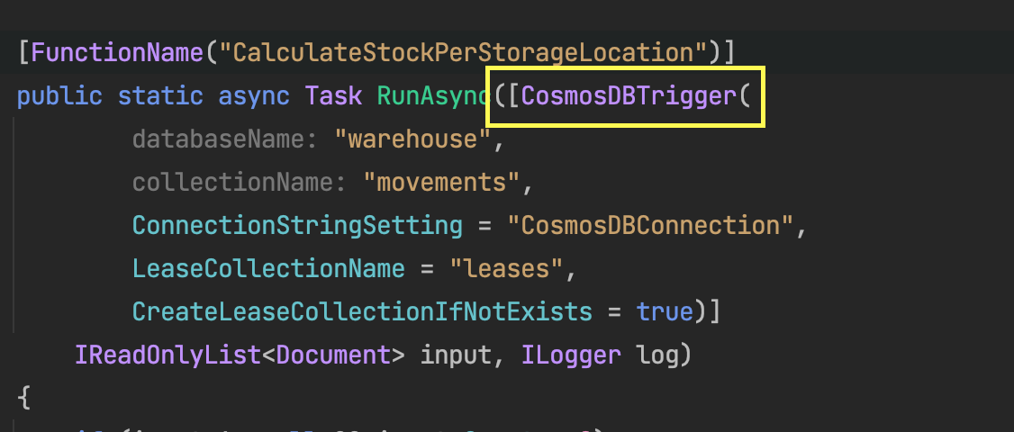
Calculate stock
Notes:
Return the service endpoint URL and access token

Slide 12
Get storage locations
Notes:
Return the service endpoint URL and access token

Slide 13

Less code
Notes:
Reporting, shipping, receiving, inventory tracking, pick-and-pack, labor management

Slide 14


Slide 15
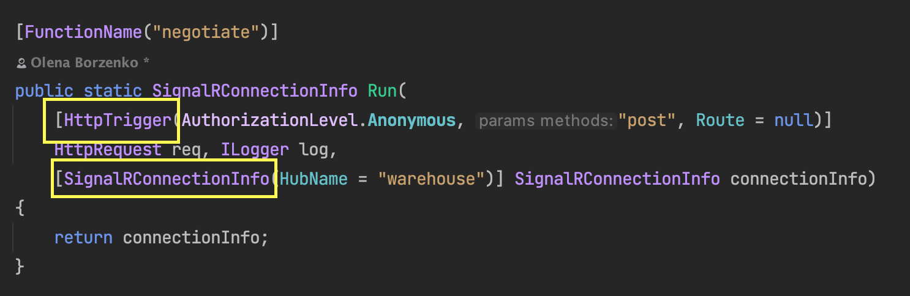
Retrieve SignalR connection info
Notes:
Return the service endpoint URL and access token

Slide 16
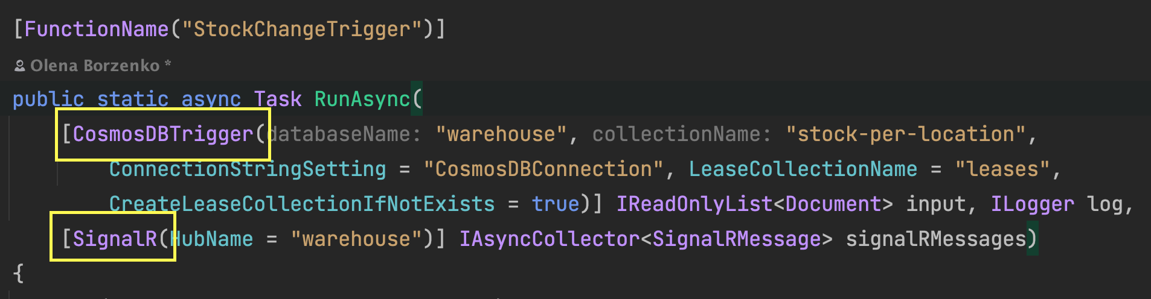
Stock change trigger
Notes:
Return the service endpoint URL and access token

Slide 17
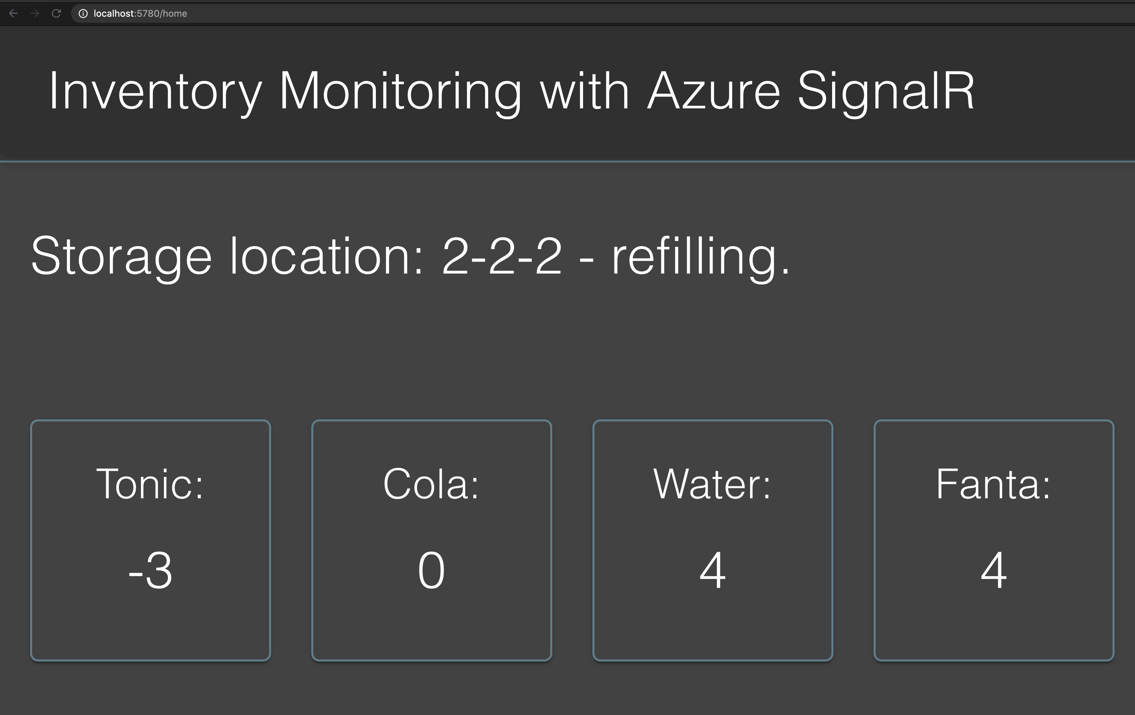
/api/negotiate
SignalR
Binding
WebSocket
Notes:
/api/negotiate

Slide 18
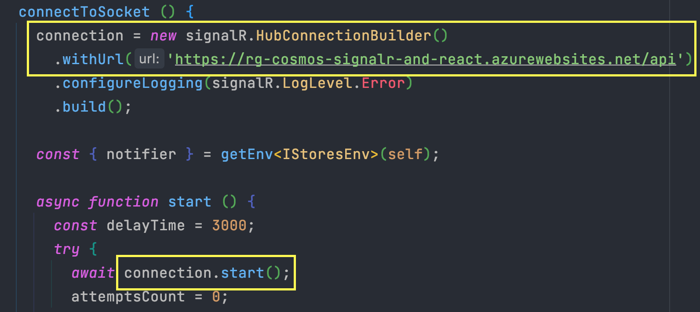
Create SignalR connection – React app

Slide 19
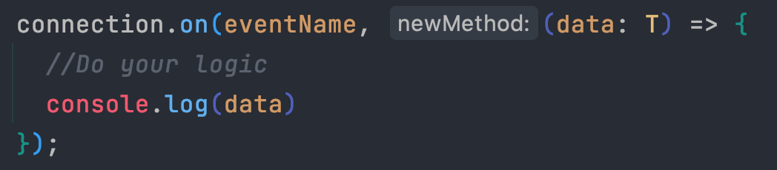
Receive SignalR messages

Slide 20


Notes:
is a library that helps you organize your application states in a very structured manner.

Slide 21
Why I like MobX-State-Tree
Centralized stores
Data is easy to use but it’s protected
Normalize your data
Notes:
MST provides centralized stores for your data
Your data is mutable, but can only be mutated in "actions", so it's easy to use but also protected
MST has built-in support for references so you can normalize your data across your whole app

Slide 22
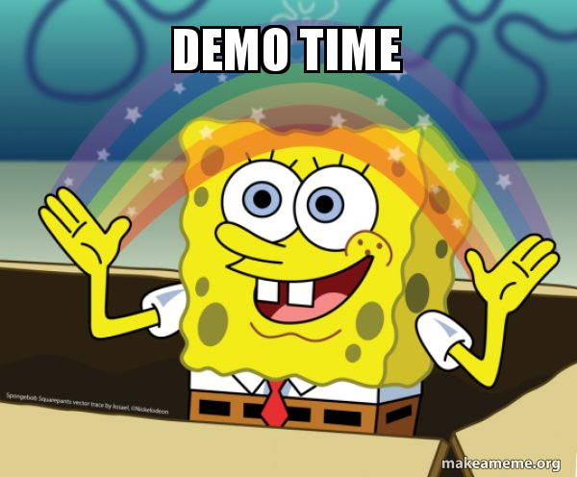

Slide 23
Summary
Azure Functions => less code;
Concentrate on business logic;
Simplicity in building separate components;
Notes:
MST provides centralized stores for your data
Your data is mutable, but can only be mutated in "actions", so it's easy to use but also protected
MST has built-in support for references so you can normalize your data across your whole app

Slide 24
Going real time using Azure CosmosDB and React
Olena Borzenko
@borzenko_lena
Linkedin: olena-borzenko

